Slide 1
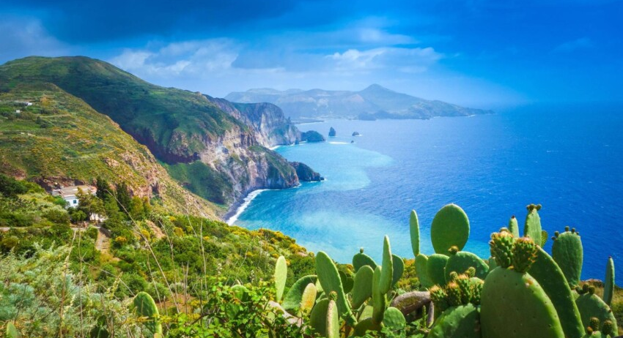

Greening the Islands Observatory
Mr. Gianni Chianetta
Chair
1st Online Webinar – Interreg Euro Med - NSTO
28 March 2025

Slide 2

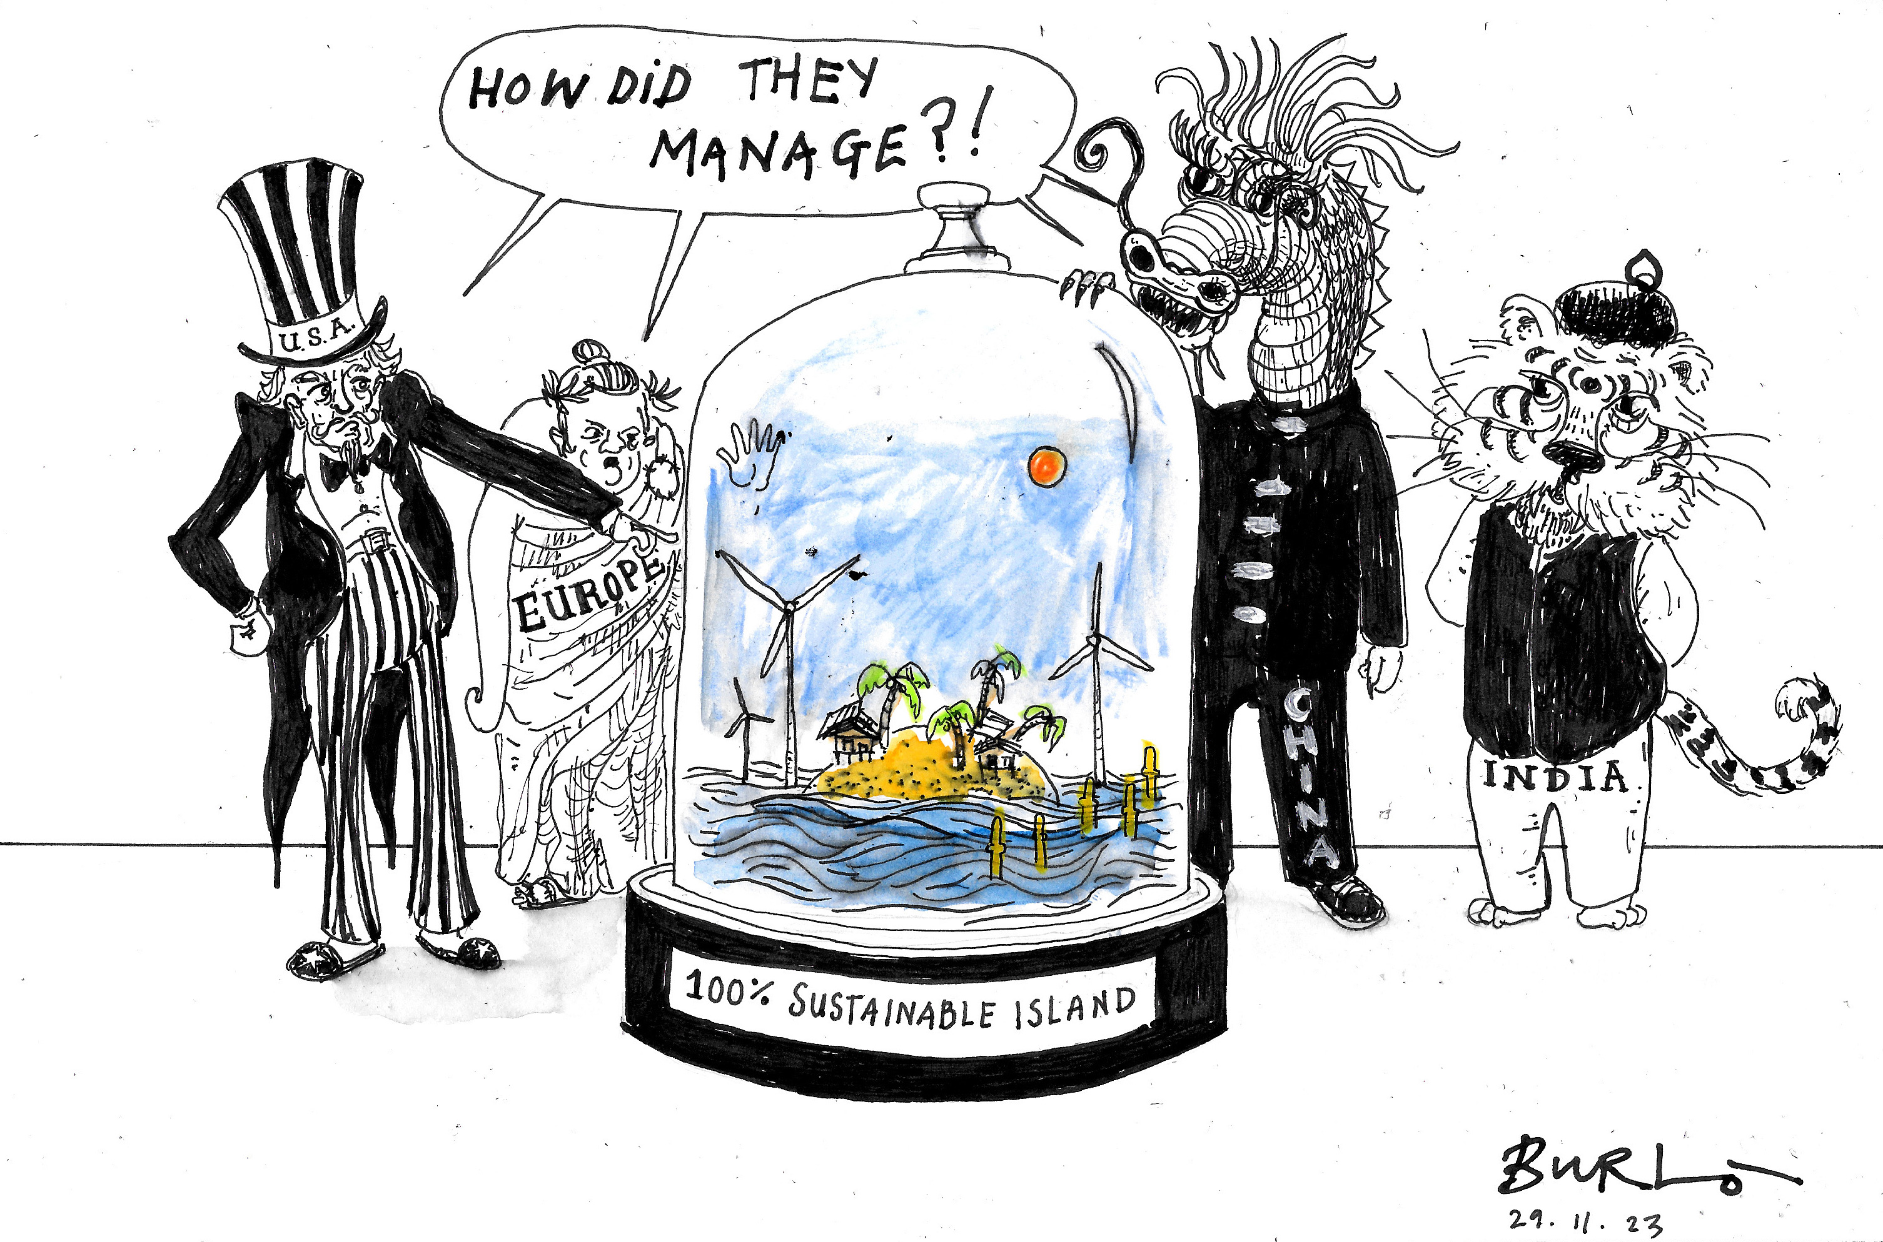

A crisis islands have not created, but they can help solve
Even though their contribution to climate change is close to zero, islands are disproportionately affected by its worst effects.
Rodrigues
As laboratories for innovation and adaptation, islands can lead the way in developing resilient communities worldwide.
greeningtheislands.org

Slide 3






The global challenge of islands
Water
High dependence on ship tankers for supply with costs up to 4x higher than desalination, losses in water grids and poor quality
Energy
High dependence on diesel imports and low energy security
3-5x cost of power production with fossil fuels compared with renewables
Mobility
One of the most polluting sectors
Common endothermic vehicles are uneconomical: useless features, higher maintenance
and fuel costs
Waste
Higher costs due to insufficient recycling facilities and consequent transportation to the mainland
Islands spend enormous financial resources while
sustainable technologies can unlock huge savings

Slide 4
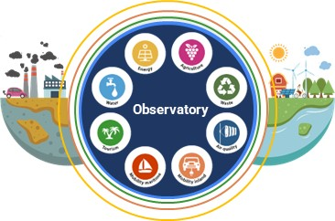






Greening the Islands: our Mission
We raise awareness
about islands’ challenges
& opportunities
We promote & strengthen cooperation among
diverse stakeholders
We support islands’ sustainability
& self-sufficiency
How we operate
Rodrigues
OBSERVATORY
TECHNICAL SUPPORT
Advocacy
Origination
Knowledge
Development
Cooperation
Financing
greeningtheislands.org

Slide 5
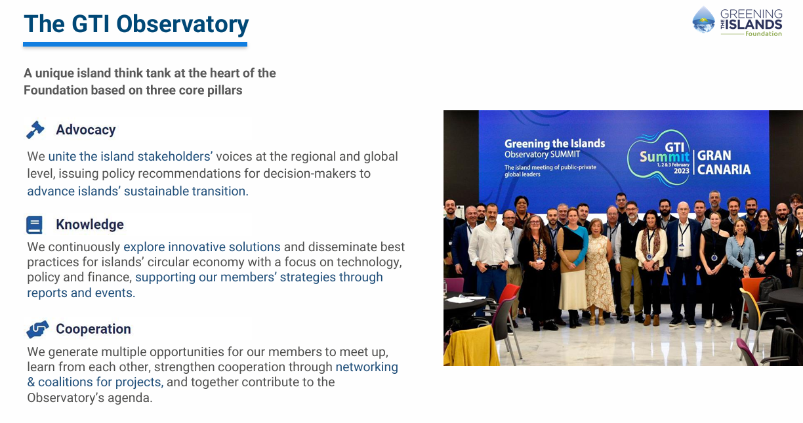
Rodrigues
greeningtheislands.org

Slide 6


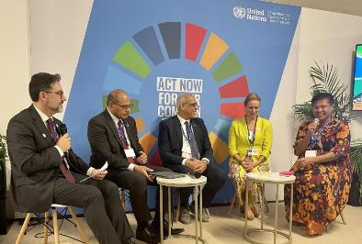
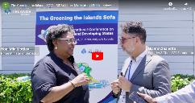
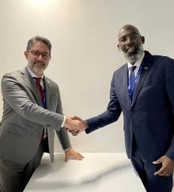
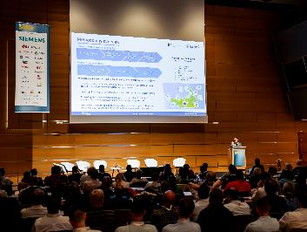
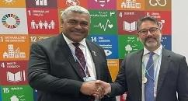
Why to join GTI Observatory
GLOBAL REACH
NETWORK
ORIGINATION
SUPPORT
More than 10,000 stakeholders (incl. industrial associations & global corporations)
Privileged access to key decision makers (e.g. international institutions and companies)
Lead the start-up of significant projects
Technical support throughout the implementation phase (incl. financing)
Joint event GTI – United Nations’ DESA at COP28
Gianni Chianetta (GTI Foundation Chair) with Mia Mottley (Prime Minister Barbados) and Sai Navoti (Chief of SIDS Unit at United Nations)
Gianni Chianetta (GTI Foundation Chair) with Gilmar Pisas (Prime Minister of Curacao)
Intersolar Europe 2024 in Munich: GTI presentation of 100% RES Islands initiative
greeningtheislands.org

Slide 7






































Our Committees
Island Advisory Committee
Composed by island stakeholders, identifies the islands’ challenges and priority needs with a focus on circular economy
Strategy Scientific Committee
Composed by international institutions and organizations expert in sustainability-related sectors, addresses islands’ challenges providing recommendations to the other Committees
Island Companies Committee
(Advisory Board)
Composed by island-based companies, represents the islands’ private sector needs and its role in the local sustainable economic development
greeningtheislands.org

Slide 8
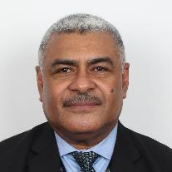



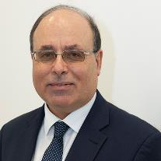



The GTI Observatory Committees
Island Advisory Committee (IAC)
Strategy Scientific Committee (SSC)
Composed by key international islands’ stakeholders
Composed by international scientific institutions
Chair
Chair
Vice-Chair
Vice-Chair
Sai Navoti
Chief of the Small Island Developing States (SIDS) Unit,
at the United Nations
Marit Brommer
CEO of the International Geothermal Association (IGA),
Vice-President of the Global Renewable Alliance (GRA)
Joseph Borg
Chairman INSULEUR
(the Network of Insular Chambers of Commerce and Industry of the EU)
Vanessa Toré
Member of the Steering Committee
of the Global Water Partnership – Caribbean (GWP)
More on https://greeningtheislands.org/observatory/
greeningtheislands.org

Slide 9
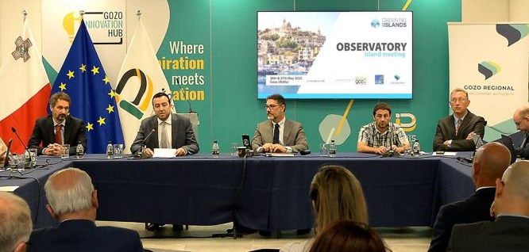
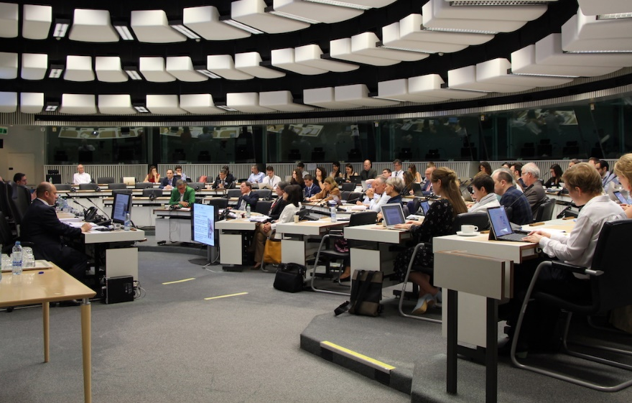
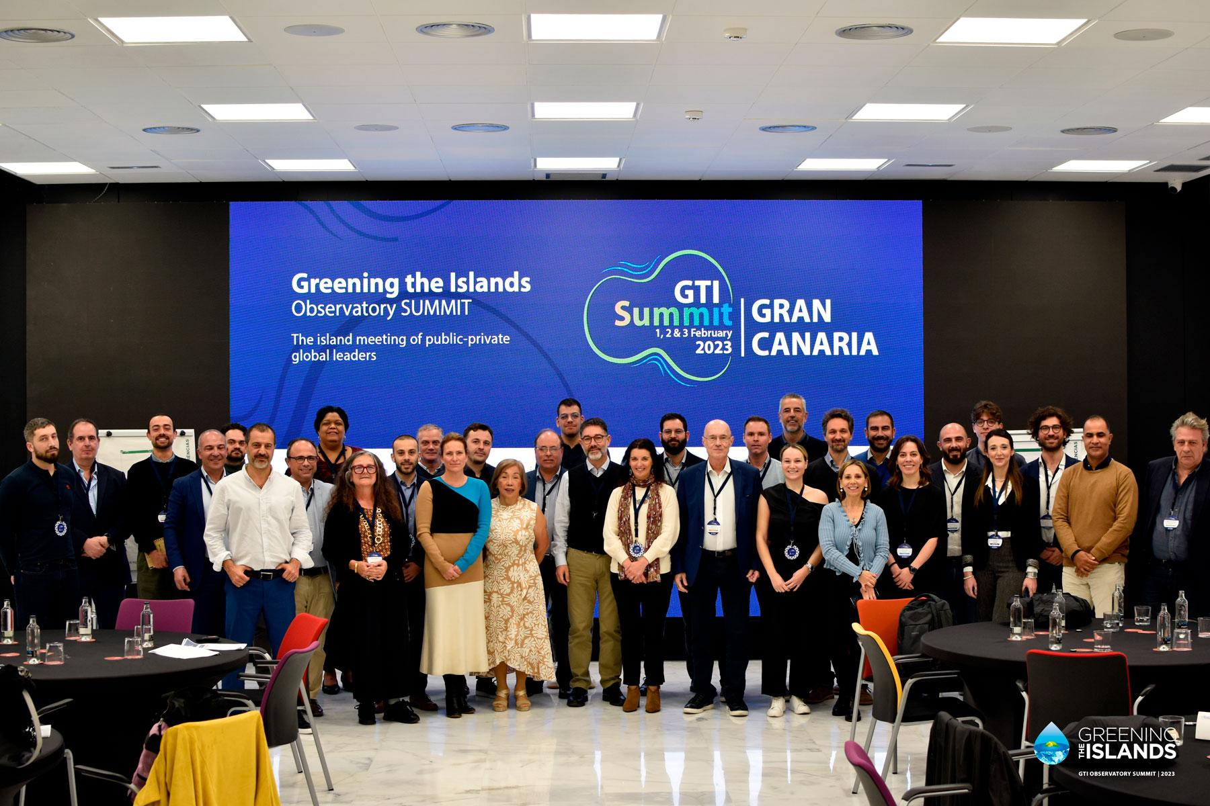
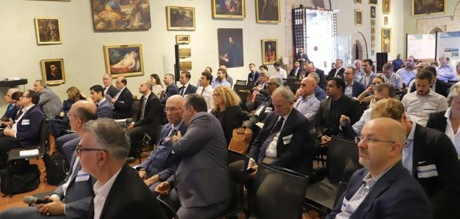
GTI Events:
knowledge sharing & multi-stakeholder cooperation
Events bring together representatives from islands at local, national, international and global levels, governments, institutions, industrial partners & industrial associations
GTI Observatory meeting and workshop on Sustainability Index application in Gozo (Malta), May 2022
GTI Observatory Global Summit in Gran Canaria, February 2023
Greening the Islands and CPMR Islands Commission at Committee of the Regions in Brussels, June 2019
6th International Conference & 4th Greening the Islands National Conference, October 2019, Palermo
greeningtheislands.org

Slide 10
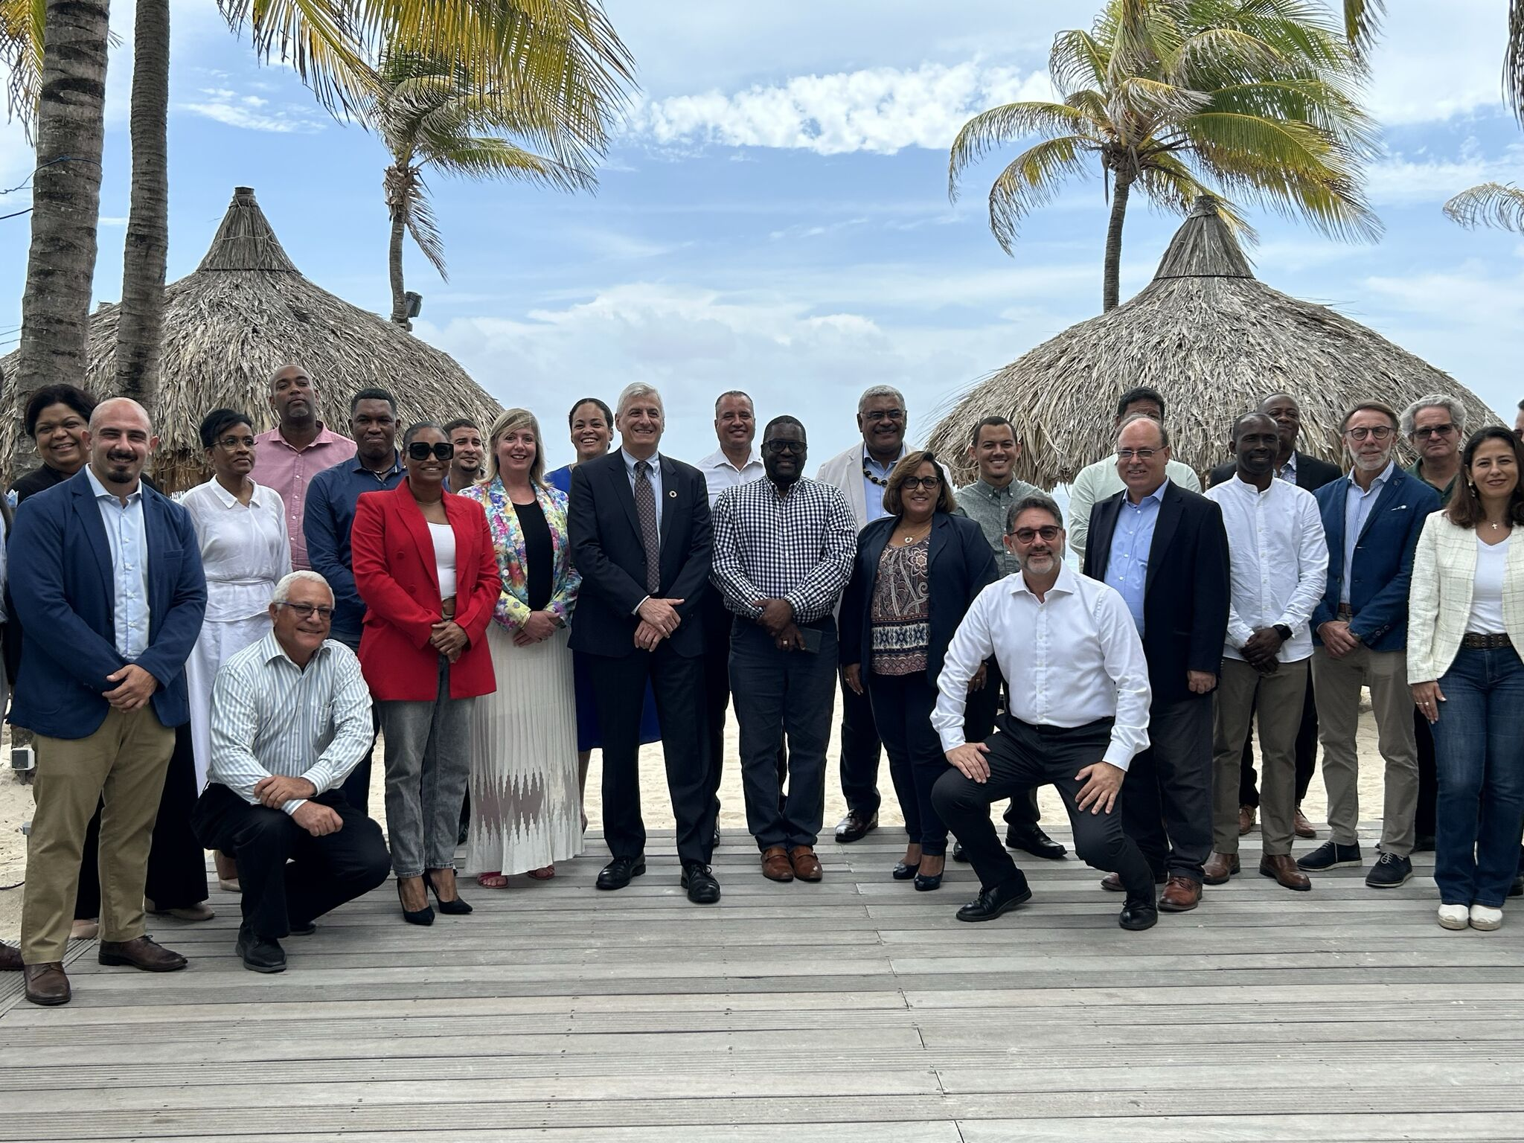
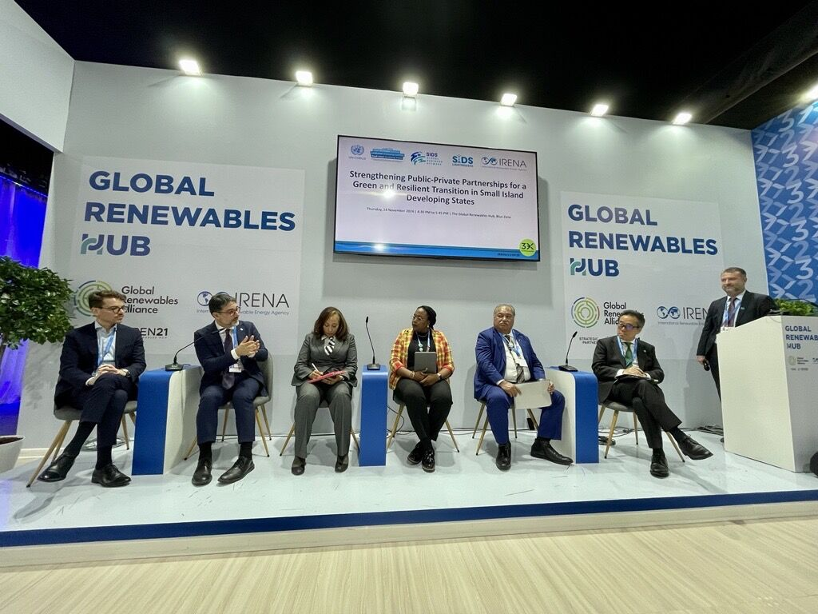
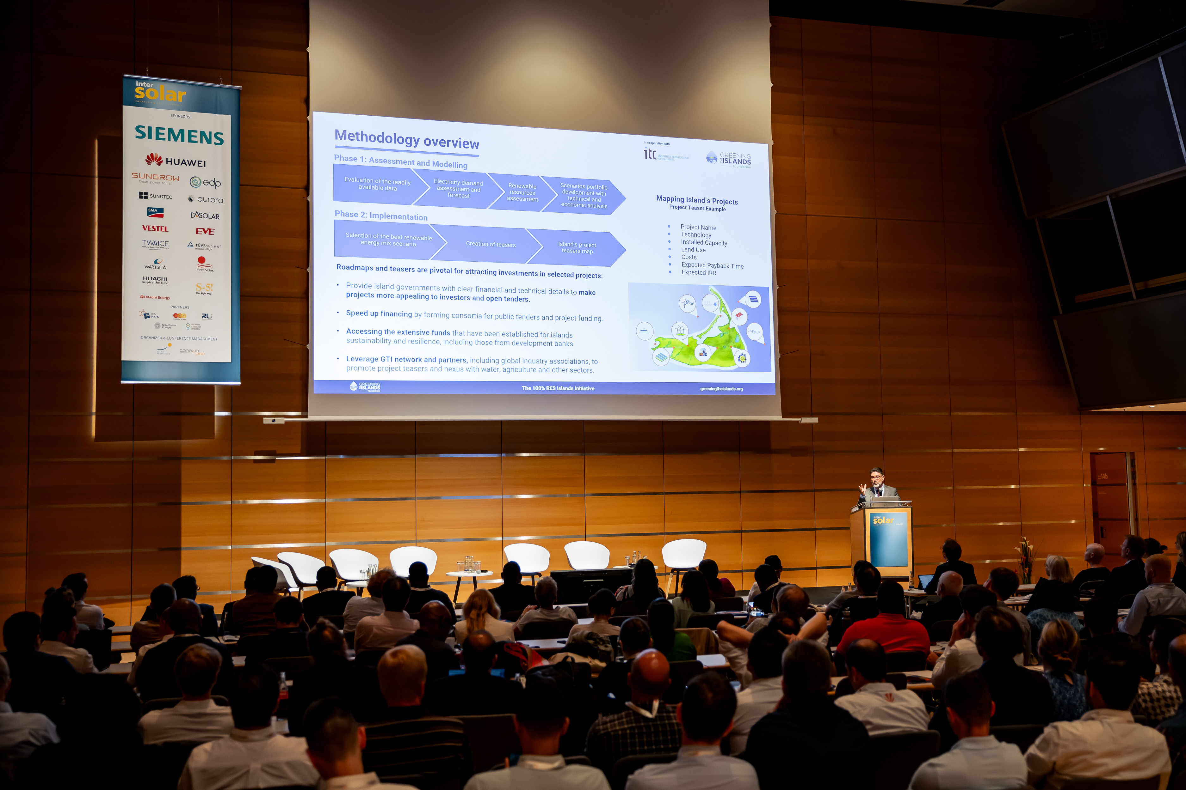
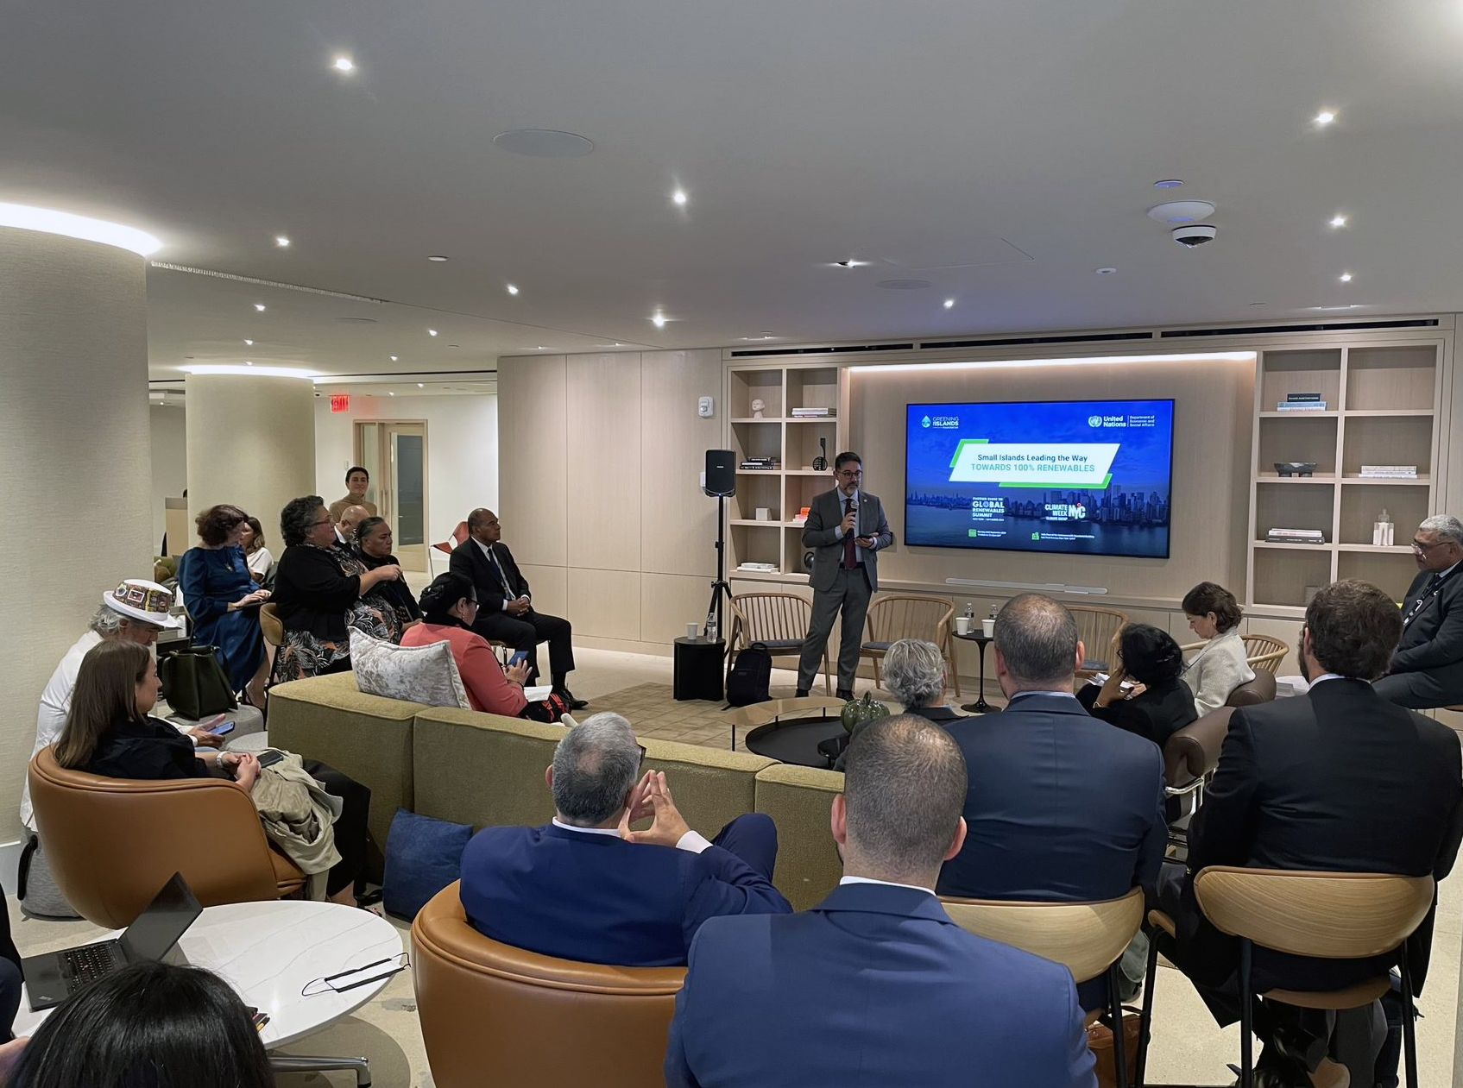
And we are active on the global scene
at the most prestigious climate events
Inter-Solar, New York Climate Week, IRENA General Assembly and COP are amongst the key global events where GTI delivers its messages by giving voice to the islands and showcasing to the world islands’ best examples
GTI Global Summit in Curaçao, October 2024
COP29 event at Global Renewables Alliance – IRENA pavilion, November 2024, Baku (Azerbaijan)
GTI opening speech on 100% RES Islands initiative at off-grid session,
Inter-Solar, Munich (Germany), June 2024
GTI event at Commonwealth office at New York Climate Week, September 2024
greeningtheislands.org

Slide 11








GTI Global Sustainability Index
A monitoring tool for sustainability of small islands
GTIO Global Index overview
Measure small islands’ sustainability
Convert data into visual grading factors
Record periodical sustainable development metrics
Analyse the island's data focusing on CO2 levels and existing and planned projects
Identify inefficiencies and areas for improvement for each sector
Island Report provides sector scores, overall score, good practices and recommendations
Step 1
Objectives
Enable quick perception of sustainability progress
Support comparative analysis and database creation
Group islands with similar needs to find synergies
Support islands’ decarbonization strategies
Step 2
Step 3
Monitoring
greeningtheislands.org

Slide 12







GTI Global Sustainability Index – Key Areas
New areas under development
80%
20%
50%
12,5%
Key for decarbonization
Accounts for both Electricity and Thermal Power contributions
Efficient waste management practices are based on the advancement of separate collection systems
Qualitative assessment of initiatives for environmental concerns (e.g., energy/environmental planning tools, protected natural areas) and their implementation status
12,5%
25%
Focus on sustainable water management considering production, distribution and treatment
Solutions for sustainable transportation include EV share, public transport, and charging infrastructure
Weights are based on funds allocated within the Horizon 2020 framework
Monitoring
greeningtheislands.org

Slide 13
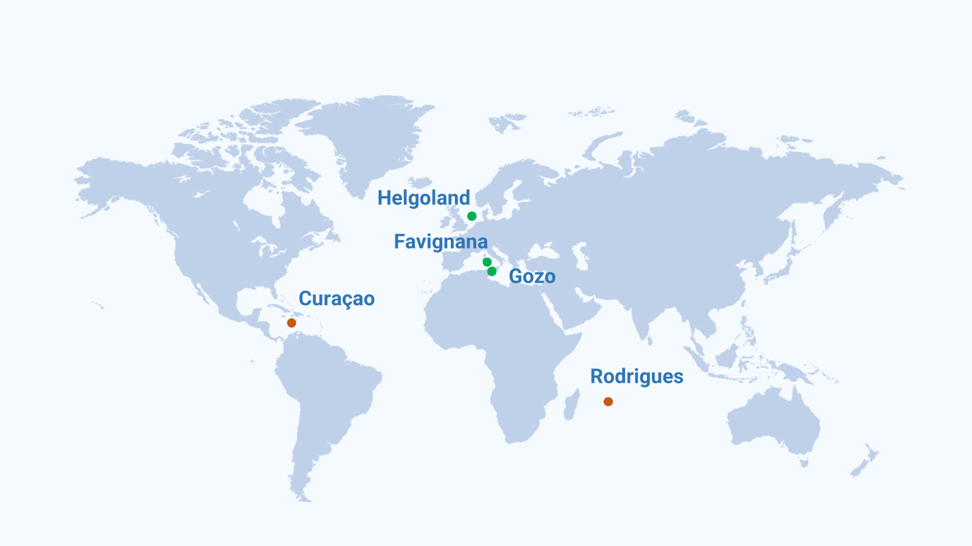
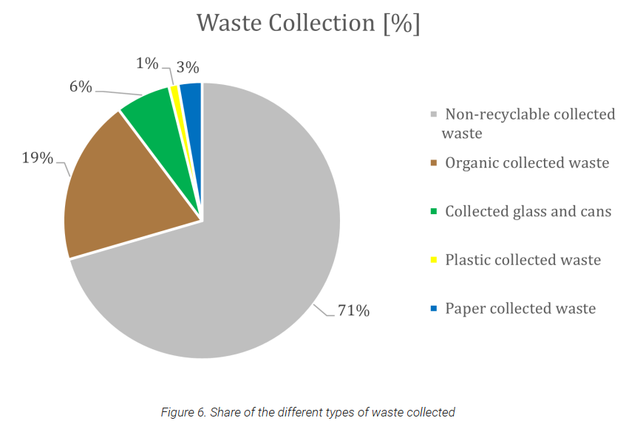
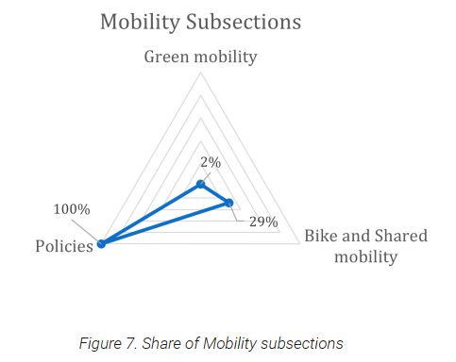
GTI Global Sustainability Index – Case Study
GTI Global Sustainability Index is being applied in 5 islands worldwide
Examples of analysis and scoring
Aimed at defining the as-is situation and highlight opportunities for sustainability journey on islands
Quantitative results based on deep-dive questionnaires & interviews on every specific topic
Several experts (specialists) involved in each island to get the details and deliver training
Full report available for island’s use
Opportunity to cluster islands based on common needs & projects
Monitoring
greeningtheislands.org

Slide 14







Consultation in Nadi, Fiji
(September 2023)
Consultation in Kingston, Jamaica
(February 2024)
Consultation in Victoria, Seychelles
(March 2024)
Indicators for IRENA
Development of a set of progress indicators and impact measures to track the progress and measure the impacts of the implementation of the IRENA SIDS Lighthouses Initiative (LHI) priority areas at the national, regional and global levels
65+ Delegates from SIDS, development institutions, partner organisations, associate members
41 indicators
3 case studies
12 priority areas covered (energy and non-energy sector)
3 Regions (Pacific, Caribbean, AIS), 28 SIDS represented
Monitoring
greeningtheislands.org

Slide 15



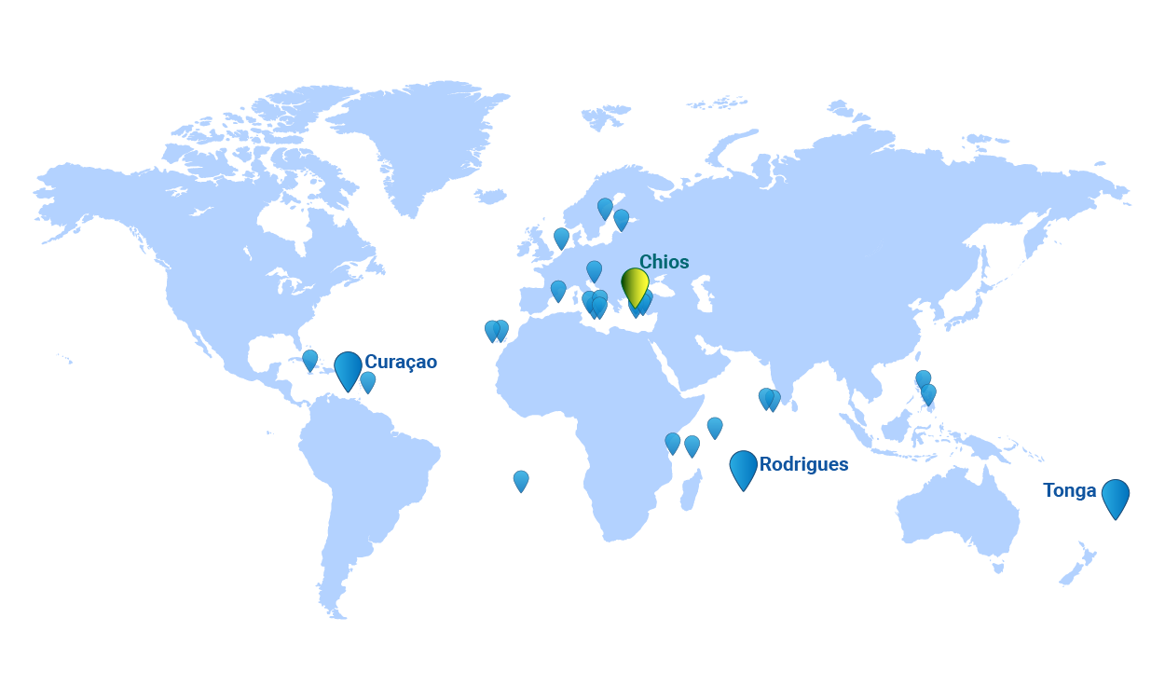




GTI 100% RES Islands - Concept
Islands as laboratories to showcase that the transition to 100% renewable energy systems is technically and economically feasible as well as a key driver for resilience.
Key partners & supporters
Objectives
Develop roadmaps for islands to rapidly reach 100% renewables
Disseminate case studies for broader and accelerate renewables deployment
Build a pipeline of projects grouped in regional and technological clusters
Involve global leaders to replicate the island model on the mainland
Rodrigues
Frontrunner Islands
Islands interested to join the initiative
The 100% RES Islands Initiative
greeningtheislands.org

Slide 16
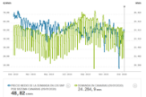
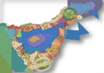

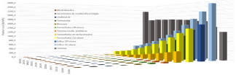
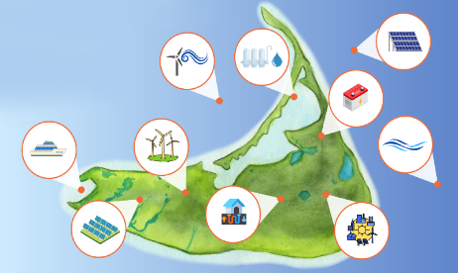
GTI 100% RES Islands – Methodology Overview
In cooperation with
PHASE 1: ASSESSMENT AND MODELLING
Evaluation of the readily
available data
Electricity demand
assessment and forecast
Renewable resources assessment
Scenarios portfolio development with technical and economic analysis
PHASE 2: IMPLEMENTATION
Selection of the best renewable
energy mix scenario
Island’s project teasers map
Definition of strategic roadmap
Rodrigues
Mapping Island’s Projects
Project Teaser Example
Roadmaps and teasers are pivotal for attracting investments in selected projects:
Provide island governments with clear financial and technical details to make projects more appealing to investors and open tenders
Speed up financing by forming consortia for public tenders and project funding
Accessing the extensive funds that have been established for islands sustainability and resilience, including those from development banks
Leverage GTI network and partners, including global industry associations to promote project teasers
Project Name
Technology
Installed Capacity
Land Use
Costs
Expected
Payback + IRR
The 100% RES Islands Initiative
greeningtheislands.org

Slide 17
Policy & Advocacy achievements
GTI and GRA: Energy transition planning recommendations for islands
In partnership with the Global Renewables Alliance, the document was published at New York Climate Week 2024 to provide guidance to island governments and stakeholders on how to achieve a rapid and sustainable energy transition.
GTI Foundation's written input for SIDS4
The document, submitted during the SIDS4 conference in 2024, advocated for including the transition to fully renewable energy systems as a key priority for small island developing states in the next decade, aiming to inform the outcomes of the UN event.
The GTI Observatory Manifesto of Gran Canaria
The collaborative outcome document of the GTI Observatory Summit 2023 raises awareness on the interconnected challenges faced by small islands and puts forth a set of key guiding principles for island stakeholders to promote holistic sustainable development.
The role of Airborne Wind Energy to facilitate the renewable energy transition on islands
In partnership with Airborne Wind Europe, the paper explores the potential of airborne wind energy as an innovative asset to integrate small islands’ transition to renewable and resilient energy systems.
GTI recommendations with EASE and EUROBAT: Islands, batteries, and the upcoming regulation
In partnership with EASE and EUROBAT, this document provided recommendations on the role of batteries for the specific case of islands’ energy transition, to inform the development of a new EU regulation related to batteries and energy storage.
Policy & Advocacy
greeningtheislands.org

Slide 18
Further GTI Activities
Strengthening GTI Foundation positioning
Global Solar Council
Managed interim Secretariat of the global association of the solar industry from 2020 to 2023, launching international studies, creating significant partnerships, joining leading sustainability and energy events. Our Chair still is Board Member and Secretary of the Management Board.
Global Alliance for Sustainable Energy
Currently coordinating the Secretariat of a unique global alliance formed by key energy players and leading international organisations to ensure the sustainabiity of the renewable energy transition.
Mediterranean Dialogue on Sustainable Energy and Climate
Currently coordinating the Secretariat of the first Mediterranean-led platform dedicated to multi-stakeholder cooperation for a just energy transition in the region, launching international campaigns and joining leading sustainability and energy events.
Global Renewables Alliance
Our Chair was amongst the founders and VicePresident of GRA.
GTI is currently the strategic partner of GRA for the islands on the 100% RES Islands flagship initiative.
Further GTI Activities
greeningtheislands.org

Slide 19
Thank you
Sustainable Islands for a sustainable world

