Slide 1
The strategic importance of a Network of Observatories in Sustainable Tourism: Challenges and issues involved
and possible solutions
Giuliano Tallone
D4T– REGLAZ - Italy
Online webinar
March 28th, 2025

Slide 2
The Network of Sustainable Tourism
Observatories (NSTO)
Bring together different actors (Observatories and organizations dealing with tourism) involved in data management (collect, analyses, studies…) for Sustainable Tourism and build multilevel cooperation for best solutions (share and transfer of data, develop joint projects, feed the existing HUB, create new data…)
Enhance Mediterranean Governance, combat seasonality, and improve cooperation among tourism actors;
Establish an open network in MED area of public and private institutions that work at different levels in the field of data management for sustainable tourism
Address the problem of the lack of statistical data, particularly at the regional/destination level

Slide 3
THE PATH OF THE NSTO INITIATIVE
Started in the framework of the BEST MED project, one of the Strategic projects of the Axis IV –Governance (Interreg Med)
Promoted by Lazio Region and CPMR (Conference of Peripheral Maritime Regions)
Capitalized in the new Mission Sustainable Tourism, D4T project, Interreg Euro-MED program.

Slide 4
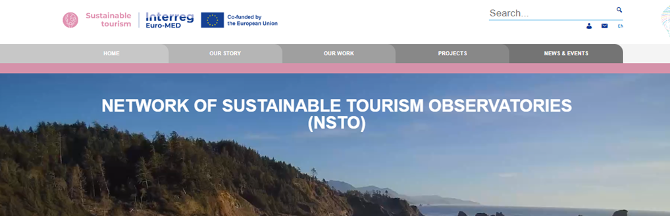
The new Dialogue4Tourism Info Hub
https://sustainable-tourism.interreg-euro-med.eu/tourism-observatories/

Slide 5
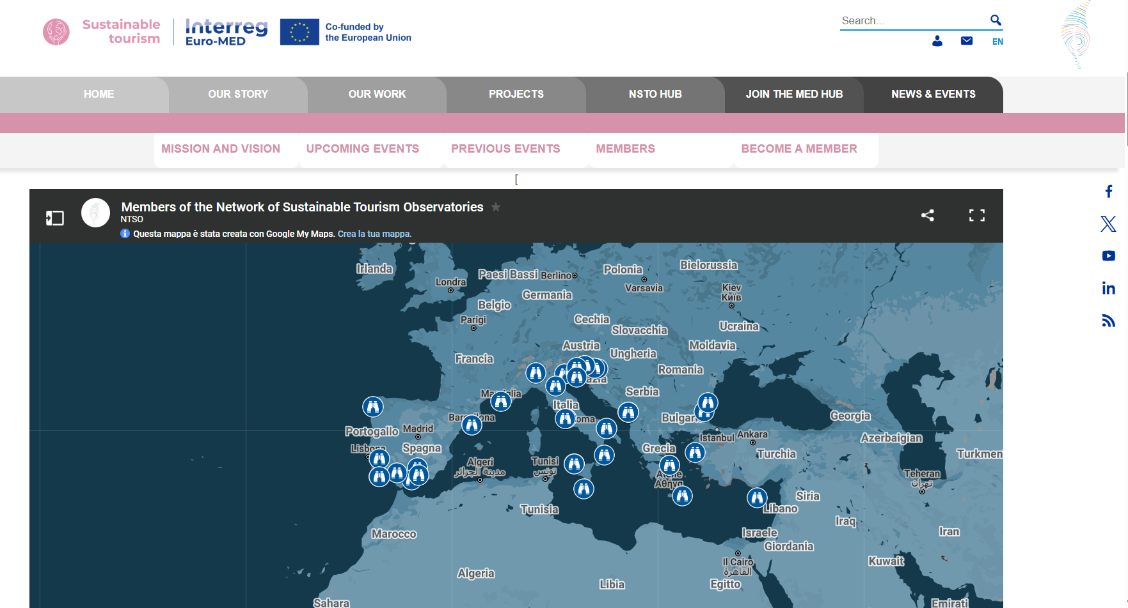

Slide 6
How?
Identify 3-5 STO around the Euro-Med area that can be considered best practices for benchmarking
Develop a P2P NSTO Support scheme at least 5 new STOs + NSTO Expert Support Scheme (ST Experts from D4T, C4T.etc)
Develop support and training material in the framework of the MED Academy / Sustainable Tourism Policy Labs (STPLs)
Implementation of the deliverable of D4T Project D.2.4.1 “Annex to the MoU of the MED NSTO”

Slide 7
How?
Implementation of MED NSTO Hub based on existing resources and make it active
Implementation of MED NSTO Hub based on existing resources and make it active
Development of the key activities of the NSTO will nourish this NSTO Hub
Provide a data collection methodology.
Set-up of Local Working Groups, to facilitate exchange among SHs levels..
Make available the data and analyses for Tourists, Policy makers, SHs.
Collaborate with C4T Project and Innovation Med Cluster to create a position paper by the end of 2025 to mainstream STOs and NSTOs as policy-making tools at all levels, including European Union and international initiatives like EC Tourism Pathway, Glasgow Declaration and UNWTO (INSTO).

Slide 8
The original idea of NSTO
Networking and experience and best practices sharing;
Definition of standards for data use and collection;
Development of a common platform for data;

Slide 9
From Best Med to D4T: EU policy scenario
Commission document «Transition patway for tourism» (4 February 2022)* in the framework of New Industrial Strategy: Building a stronger Single Market for Europe’s recovery (COM/2021/350 final) – and stakeholders platform
Council conclusions on « European Agenda for Tourism 2030» 1 December 2022
* Directorate-General for Internal Market, Industry, Entrepreneurship and SMEs

Slide 10
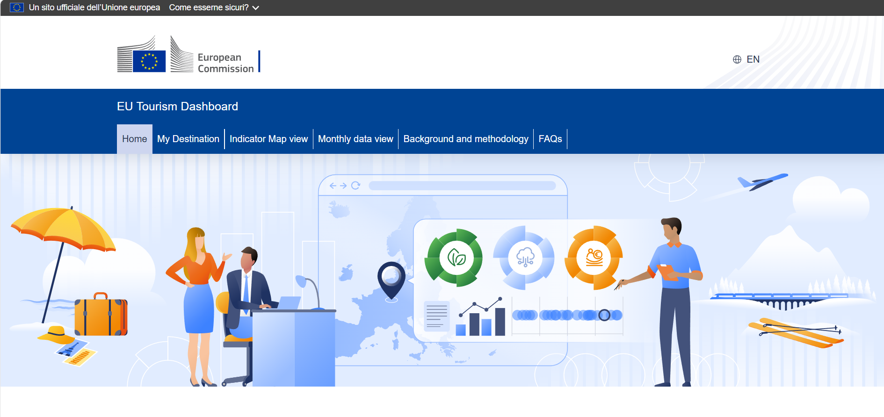
The EU Tourism Dashboard offers interactive visualisations of data and indicators relevant for the European tourism ecosystem. Its primary aim is to promote and monitor the green and digital transitions and socio-economic resilience of European tourism, and to support decision makers and operators in the field to steer evidence-based policies and strategies.
The platform also provides a set of basic descriptors on the characteristics of tourist destinations in terms of demand, supply and tourism offer. It covers all the EU countries, Iceland, Norway and Switzerland.
https://tourism-dashboard.ec.europa.eu/?lng=en&ctx=tourism

Slide 11
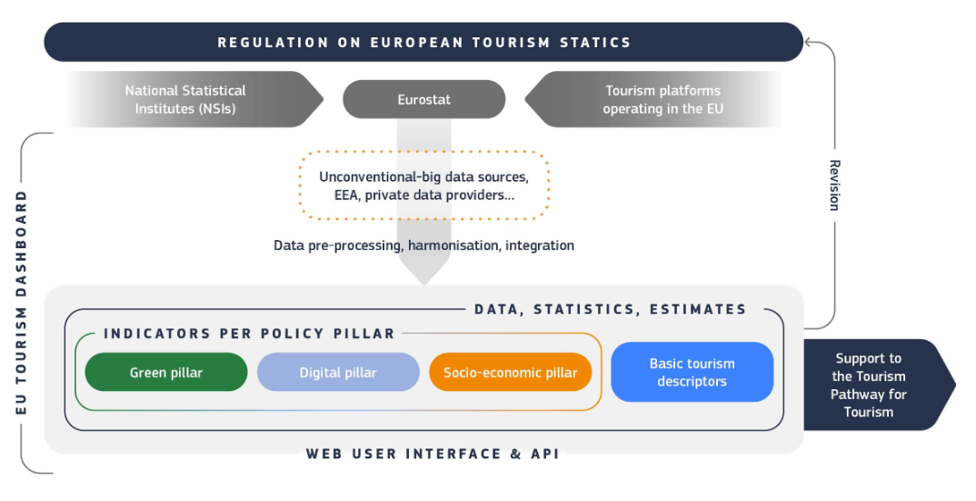
https://tourism-dashboard.ec.europa.eu/?lng=en&ctx=tourism

Slide 12
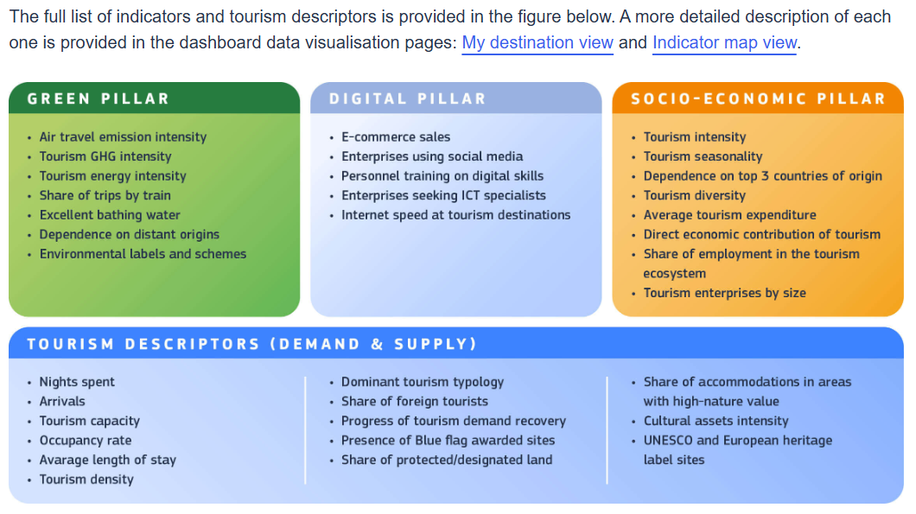
https://tourism-dashboard.ec.europa.eu/?lng=en&ctx=tourism

Slide 13
From Best Med to D4T: program scenario
Mission Sustainable Tourism of Interreg Euro-MED (C4T and D4T Twin projects)
Thematic projects of Interreg Euro-MED (from 4° Call «Enhancing sustainable tourism»: AQUAMAN, DarkSkyTour, ECO-SEAROUTES, GreenSET, INSPIRE, MED4REGEN, PortCREW, RECIRCLE MED, Regenera4MED, TO CARE MED)

Slide 14
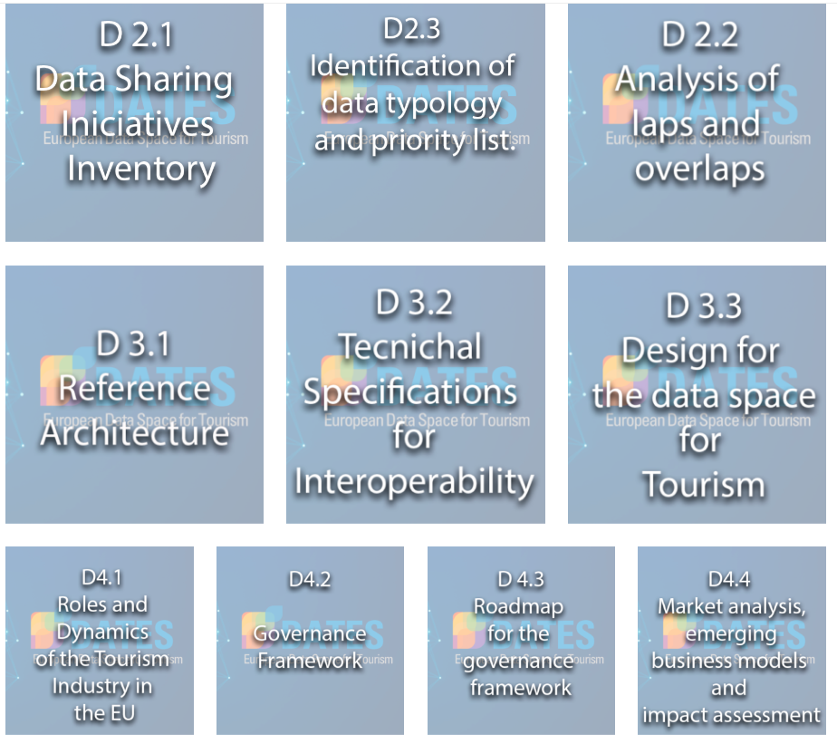
From Best Med to D4T: wider scenario
DATES Project (AnySolutions-NECSTouR) https://www.tourismdataspace-csa.eu/
DATES is a EU project that aims to explore approaches and options for the deployment of a secure and trusted tourism data space, ensuring transparent control of data access, use and re-use. The project focuses on the development of governance and business models, while providing a shared roadmap that will ensure the coordination of the tourism ecosystem stakeholders and the connection between data ecosystems at EU level and interconnected data spaces in other sectors. [The DATES project has received funding from the Digital Europe Programmeunder Grant Agreement No 101084007]

Slide 15
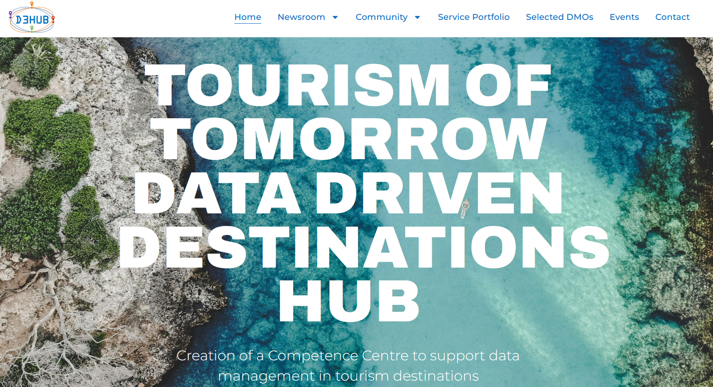
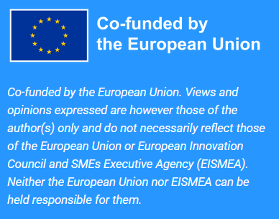
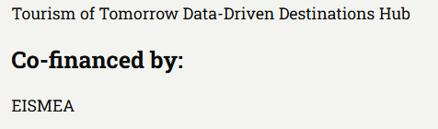
From Best Med to D4T: wider scenario
D3HUB Project (AnySolutions-NECSTouR-Andalucia-Italian Ministry of Tourism)
https://www.d3hub-competencecentre.eu/
https://tourism4-0.org/t4-0-projects/d3hub/

Slide 16
From Best Med to D4T: wider scenario
D3HUB Project
Will build a knowledge support scheme supporting tourism destinations across EU, provide tailored-made digital solutions and data for DMOs and tourism SMEs, test the developed framework through a pilot run by a critical mass of DMOs, integrate results and learnings into a business plan to set up and sustain the CC, up-scale beyond the partnership and build a data-driven tourism community, and implement the CC and ensure its continuity. The CC will focus on data, sustainability and policy (while aligning with EU tourism and data spaces) to support destinations with guidance and information related to data management, and business intelligence on how to source and use data and apply data intensive information to address policy actions and strategies.
D3HUB will result in the implementation of a knowledge hub that will empower destination ecosystem actors to switch to data-driven culture, with the objectives to:
Support data management and business intelligence for increased tourism sustainability and resilience;
Enable data-driven marketing and management; and
Foster knowledge transfer, mutual learning and best practice in data management and data sharing through European collaboration.

Slide 17
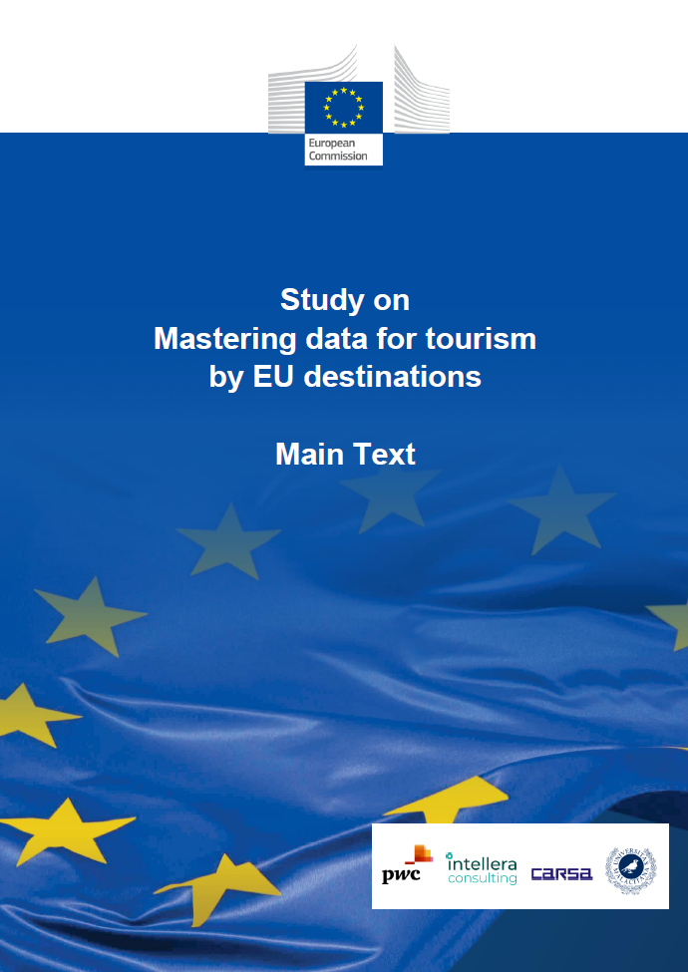
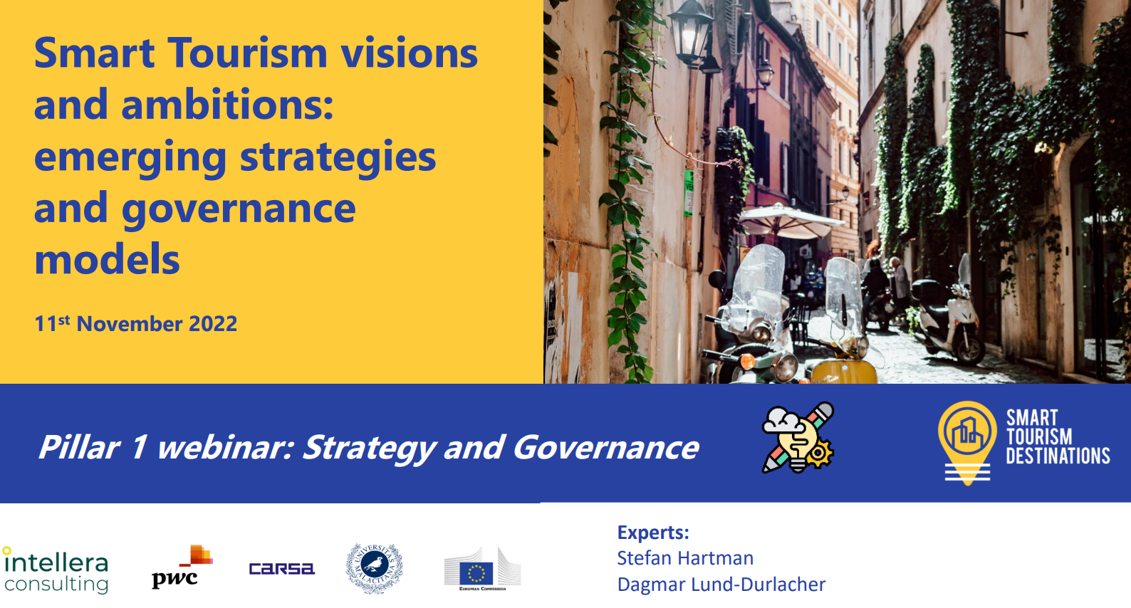

Smart Tourism Destinations is a European Commission initiative to support EU cities to facilitate access to tourism and hospitality products and services through technological innovation. EU cities will learn how to implement innovative digital solutions to make tourism sustainable and accessible, fully leveraging on their cultural heritage and creativity to improve the tourism experience.
In particular, the project will focus on how EU cities can adopt data-driven approaches to become or improve as a smart tourism destination, and it will be characterised by the involvement of a large number of stakeholders, including as policy-makers, private sectors practitioners and academic researchers.
https://smarttourismdestinations.eu/

Slide 18

From Best Med to D4T: wider scenario

Slide 19
Challenges and issues involved -> Solutions
Lack of coordination; -> Networking, dialogue
Duplication, fragmentation and dispersion of efforts -> Putting in common experiences and tools
Different approaches and methods -> Definition of a shared framework
Lack of information about available platform for data -> Information campaingning

Slide 20
The new NSTO of D4T, in the light of this complex framework
Focus on institutional «Dialogue» (software Vs hardware): networking and experiences and best practices sharing, use of the Hub to promote existing (or under development) tools and data platforms;
Dissemination events: developing circulation of information on definition of standards for data use and collection; training in cooperation with C4T and other projects;
Attention to local destinations (DMOs) and especially to local Observatories for Sustainable Tourism (local administrations, universities, research institutions, DMOs, …)
Co-operation to develop a common EU platform for data;
Support to an EU policy on data for sustainable tourism use in tourism planning

Slide 21

Thanks for your attention
https://www.regione.lazio.it
ferdinando.rossi@regione.lazio.it
gtallone@regione.lazio.it

